Slide 1

Zoom Training Session
September 2020

Slide 2
Agenda
Zoom Introduction
Access and Credentials
Schedule A Meeting
Inviting Participants to Meetings
Starting a Meeting
Joining a Meeting
Screen Controls
Breakout Rooms

Slide 3
Zoom Introduction
Zoom is a videoconferencing platform used to conduct video conference mediations.
Zoom is available on a variety of devices, including desktop PCs, laptop computers, smart phones, tablets, etc. with an internet connection.
Zoom can be used via web browser, or downloaded as an application to a device
Cameras are highly encouraged, but not required for participants. Mediator participants can simply dial in.
If mediators or parties to mediation do not have access to a smartphone or a computer with a camera, microphone, and speakers, the CDRC may be able to provide access to a computer at the CDRC office.

Slide 4
Go to www.zoom.us/signup to create or log-in to a zoom account.
Log in using your existing account, or the CDRC account:
  Username: jody.mcelravy@cdrc.org
  Password: Cally125
Once users have downloaded the program and logged in, they can create and schedule a meeting.
Access and Credentials

Slide 5

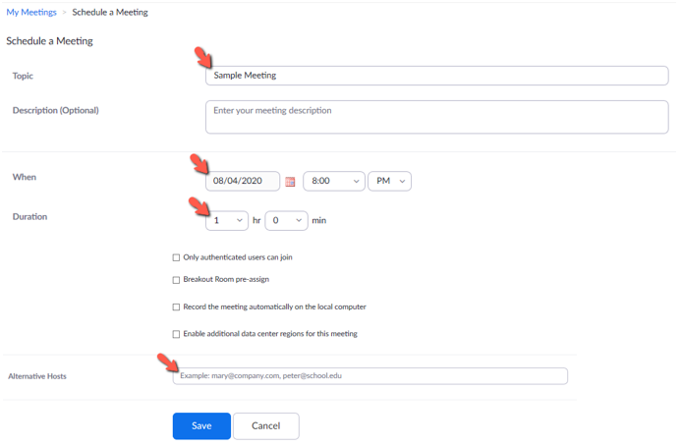
Once logged into Zoom, user may schedule a meeting.
To schedule a meeting for a later date, select “Schedule a Meeting”
Complete necessary fields, per logistics of meeting and click “Save” to secure meeting at scheduled:
Scheduling a Meeting

Slide 6
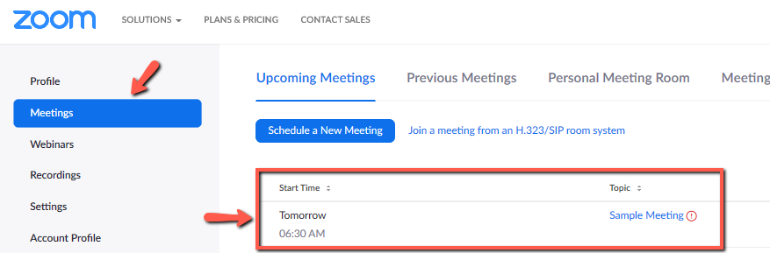
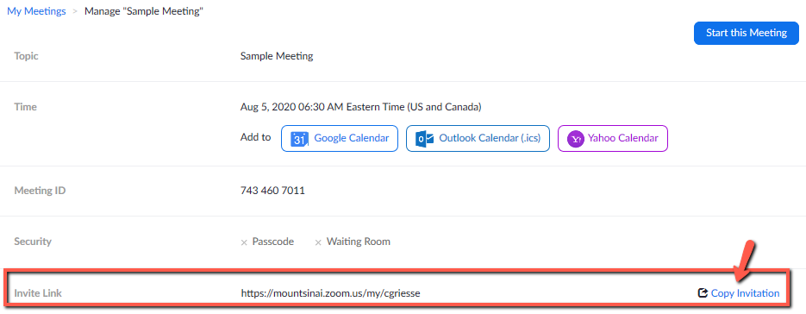
Once meeting has been created, users can invite parties of the mediation to the meeting.
Click on “Meetings” on the left side of the zoom home screen. A list of scheduled meetings will appear.
Inviting Participants to a Meeting
Click on the created meeting. Navigate to the middle of the page and select “copy invitation.”

Slide 7
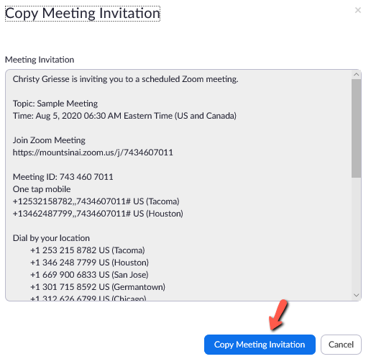
Copy and paste the meeting invitation into the email being sent to the participants.
Inviting Participants to a Meeting
Participants who were emailed the invitation link will be join the meeting by directly clicking the link, or by phone using the information on the invitation.

Slide 8
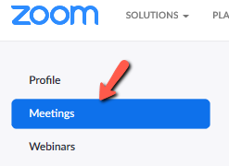
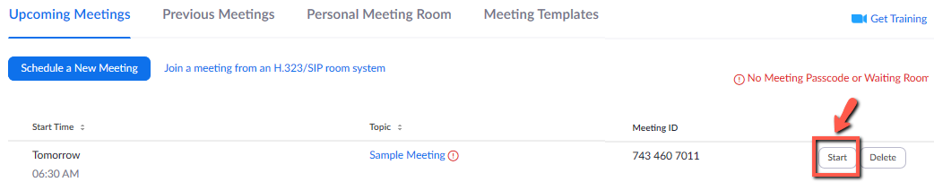
Click the Meetings icon from the menu bar on the left side of your screen.
Starting a Meeting
Click the start button to start the meeting.

Slide 9

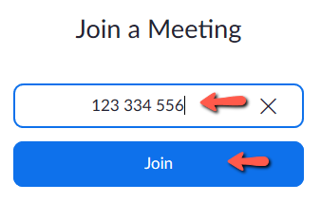
Click on “Join a Meeting” on the on the menu bar on the upper right side of your screen.
Joining a Meeting
Enter the Meeting ID or personal ID number in the box.
Click Join to join the meeting.
–OR– Simply click the link from e-mailed invitation.

Slide 10
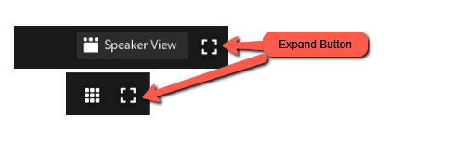
All the settings and functions of the zoom meeting are controlled with buttons in the zoom meeting window.
The top-right side of the window has two buttons:
  The View option selector allows user to choose between “Gallery View” and “Speaker View.” These are two ways of viewing the participants within the meeting.
  The full screen on/off button is in the top-right corner of the zoom meeting screen.
Screen Controls

Slide 11
Zoom meeting controls are on the bottom of the meeting screen. The buttons that end users see depend on whether they are a host/co-host or participant. Below descriptions correspond to the image below.
Mute/Unmute. Clicking this button will turn microphone on and off.
  The dropdown arrow (^) allows user to select a microphone and speaker on the device they are using.
  User can also test speaker/microphone and access to audio settings.
Stop/Start Video. Clicking this button will turn camera on and off.
  Participants with video off will appear blacked out, with name listed only.
  The dropdown arrow (^) allows user to select the camera that will be used for the meeting, open options to select a virtual background, and access video settings.
Security. Clicking this button will allow the host to lock the meeting, control the waiting room, control participant’s ability to share screens, chat, rename themselves, and unmute themselves. It also allows the host to remove participant from meeting.
Participants. Clicking this button will display a panel of participants on the right side of the window. From this area the host/co-host can control participants audio and video as well as rename them if necessary.
  The small number next to this button shows the number of meeting participants
Chat. Clicking this button will open a chat window on the right side of the meeting screen. In this window, user can send a message to a participant privately, or to all the participants in the meeting.
Screen Controls

Slide 12
Share Screen. Clicking this button allows a participant to display a document, webpage, white board, or other input from a device with the meeting.
  The meeting host/co-host can can allow all participants to share their screen, or restrict screen sharing.
  This feature is very useful when making changes to a parenting plan or mediated settlement agreement for the Justice Court. All participants can view the document and live edits.
  User will be able to choose what window/application they will share.
Record. The meeting can be recorded here if necessary.
Breakout Rooms. Clicking this button allows the host to split the meeting into two or more smaller, private meetings within the meeting.
  This is a useful feature when parties to the mediation want to caucus with the mediators and/or their attorneys.
  This feature will be described further later in the presentation.
Reactions. This button is used to send emojis to participants in the meeting.
Admitting Participants. If participants need to be admitted to the meeting, the host/co-host will see a bubble at the bottom of the screen that asks the host to admit participants to the meeting.
  Until participants are admitted, they are in a “waiting room”.
End. To end a meeting, simply click “End” on the lower right corner of your active Zoom meeting
Screen Controls

Slide 13
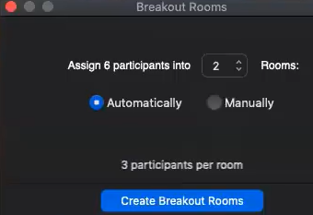
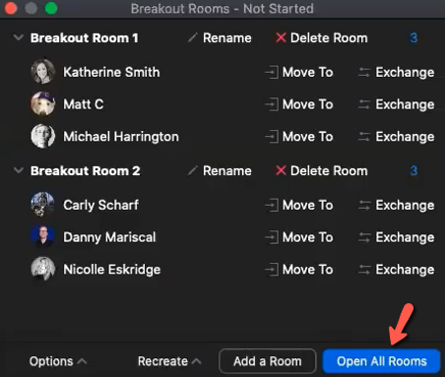
  When the break room button is clicked, a pop-up will display allowing user to choose how many rooms to create, and whether to create those rooms automatically or manually:
Breakout Rooms
Select manually and group parties with their attorney if present. The next pop-up window will allow user to manually choose assignees to rooms and edit participants in rooms. Once finished, click “open all rooms”.

Slide 14
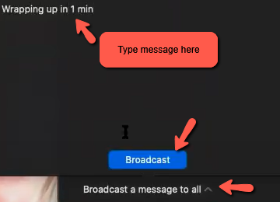
Zoom will automatically break users out into rooms, should user receive an invitation to join the breakout room, they will need to select “join”
Hosts/co-hosts can move between rooms between rooms to talk to different participants.
When participants are ready to go back to the full group meeting, host/co-host can let participants know in a message or verbally that breakout rooms are closing.
Breakout Rooms
Once participants have been notified, click “close all rooms” in the Breakout Room window. Zoom will prompt all participants to rejoin the meeting. A one-minute countdown starts, giving participants time to click back on.
Host has ability to reopen rooms as many times as needed.

Slide 15
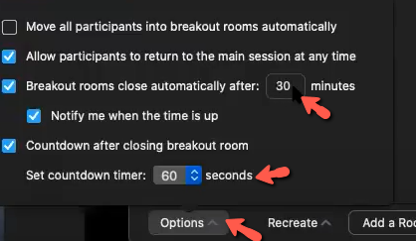
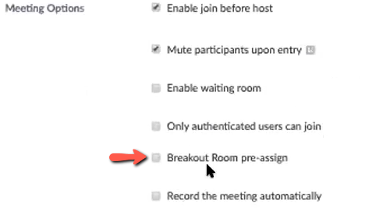
Host/Co-host also has the ability to place a specified time on the breakout rooms to automatically close after a certain number of minutes and can alter the countdown after closing breakout room timer:
Breakout Rooms
Host/Co-host also has the ability to preassign breakout rooms prior to the session, via the meeting options on the zoom portal.

Slide 16
Questions?

Slide 17
Appendix

Slide 18
Topic. Brief description of the meeting, such as names of parties and/or parenting plan, or justice court.
Description (optional). Specific information about the meeting.
When. Date and time here using the calendar and dropdown menus.
Duration. Duration of the meeting here. Mediations are scheduled for two hours, though they may be shorter.
Time Zone. Confirm that the meeting is scheduled in Mountain Time. There is a box that may be checked to create a recurring meeting. Please note, users should not need to create a recurring meeting, but if done, they must enter the specifics, such as a start and stop date and frequency of meeting (daily, weekly, monthly, etc.).
Registration. Requires meeting and/or participants are required to be registered. Do not check this box.
Meeting ID. Allows users to choose between an automatically generated meeting ID and their personal meeting ID. Generate automatically is the default setting. This does not need to be changed.
Security. Unique meeting passcode. Depending on how participants access the meeting, they may need to enter the passcode to join the meeting. Meeting invitations will show this number to invitees. There is also a Waiting Room box in this field. Do not check this box.
Video. On/off switch for both host and participant. BE SURE THAT BOTH ARE ON.
Audio. Allows users to choose between telephone, computer audio, telephone and computer audio, and third-party audio. BE SURE THAT TELEPHONE AND COMPUTER AUDIO IS SELECTED.
Meeting Options. This field allows users to build the following options into their meeting:
  Enable join before host. Be sure this box is checked so that participants are allowed to show up early. If the box is not checked, zoom will restrict access to the meeting until the host is in the meeting.
  Mute participants upon entry. There is no need to check this box.
  Only authenticated users can join. There is no need to check this box.
  Breakout Room preassign. Users can create breakout rooms for parties and their attorneys here. Because mediation meetings are usually four participants or less, it is just as easy to do this once the meeting has started.
  Record the meeting automatically. There is no need to check this box.
Alternative Hosts (optional). This field allows users to assign an alternative host for the meeting by entering that person’s email address. This is useful if you are scheduling a meeting for another mediator.
Creating a Meeting, definitions

